Slide 1

Entity
Framework
Core
Thao Do – Hoi Bui

Slide 2
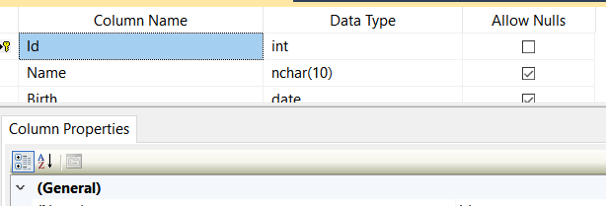
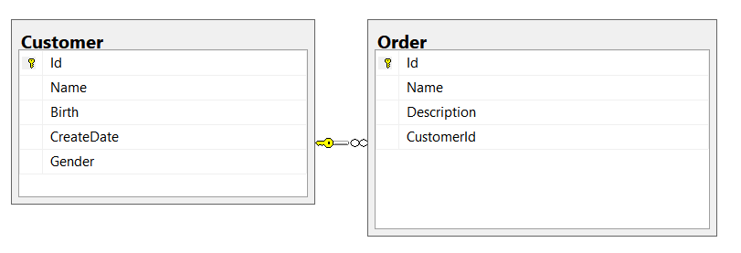
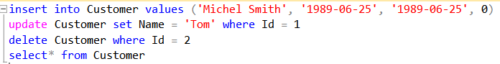
Something you know
Create table
Create relationship
Some queries: select, insert, update, delete data
Advance functions:
Store procedure
Function
Transaction

Slide 3
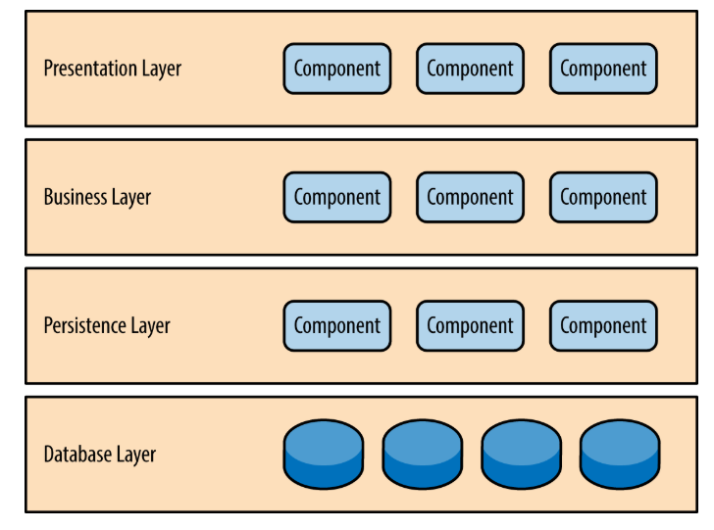
Persistent layer
Separation of concerns among components
Build effective roles and responsibility models into your architecture
Layers of isolation, it is easy and cheap to change
In .Net, we have Gentle .NET, Atoms, Object spaces, Entity framework, …
Notes:
https://www.oreilly.com/library/view/software-architecture-patterns/9781491971437/ch01.html
Nếu viết EF => SQL ra sao

Slide 4
Entity Framework
Entity Framework is an object-relational mapper (O/RM) that enables .NET developers to work with a database using .NET objects. It eliminates the need for most of the data-access code that developers usually need to write.
=> Entity Framework Core

Slide 5
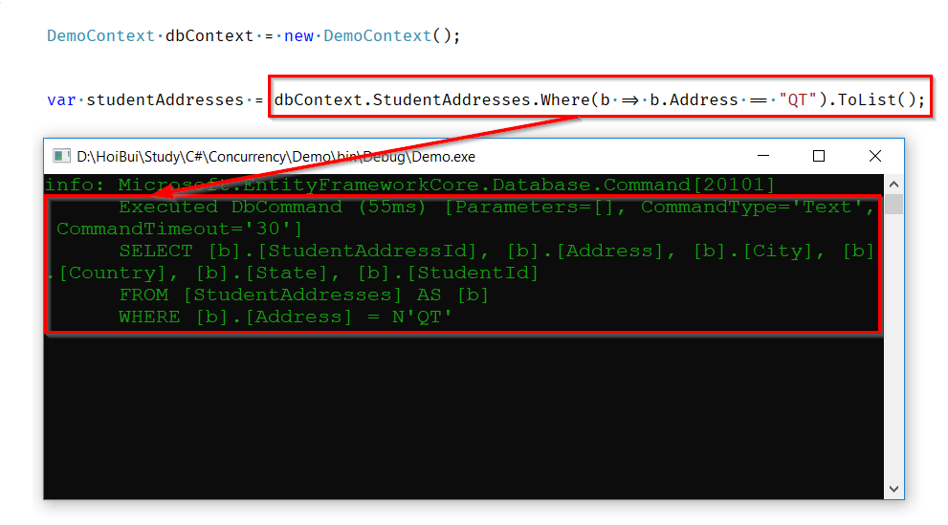
How does Entity Framework Core work?

Slide 6
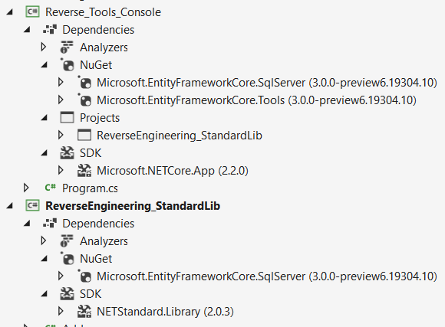
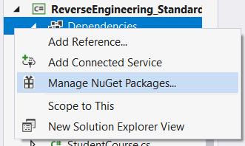
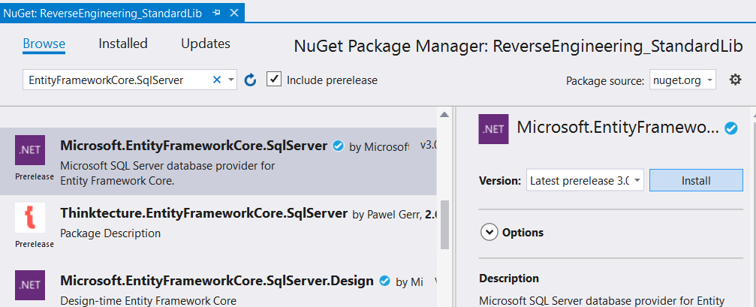
Install packages
Notes:
Comment the connection string
Thêm điểm nhấn vào các slides
Migration: - Nói rõ phần Up/Down database: chèn cột, chèn DB
Nói cách load DB: select trước khi nói đến loading strategy
Config cho lazy load

Slide 7
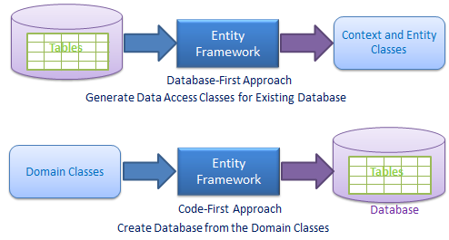
How to begin?
Database First
Having a existing database
Risk of data loss will be kept to a minimum, because any change or update will be always performed on the Database
Code First
No need for diagrams
Can be great for small-to-medium size projects as it will save us a lot of time

Slide 8
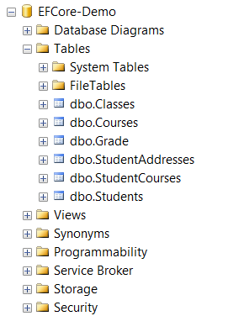
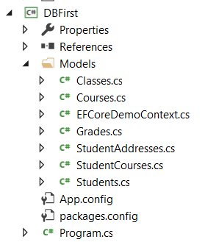
Database first
1
2
Note: EF Core creates entity classes only for tables and not for StoredProcedures or Views.

Slide 9
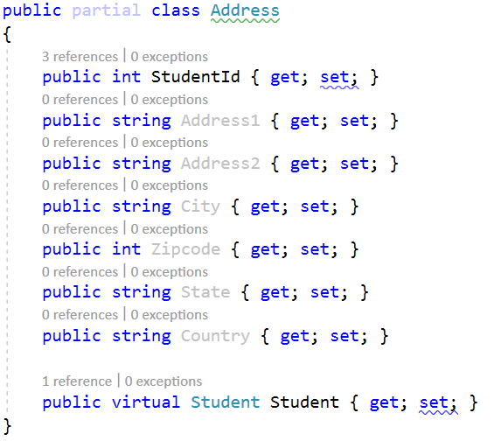
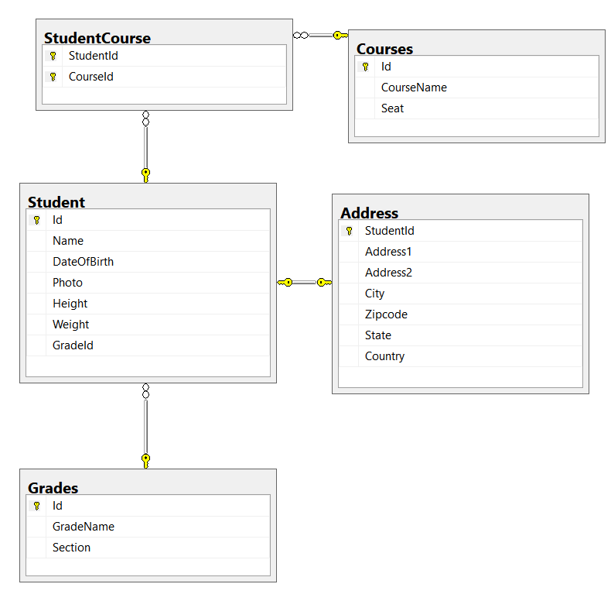
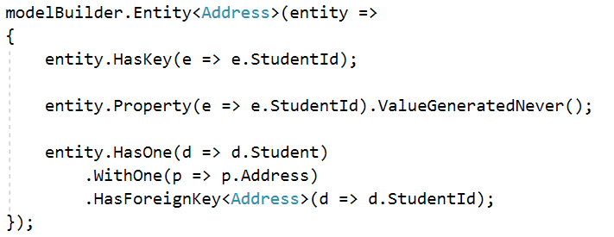
Relationship - Mapping object
1:1 – Student : Address

Slide 10
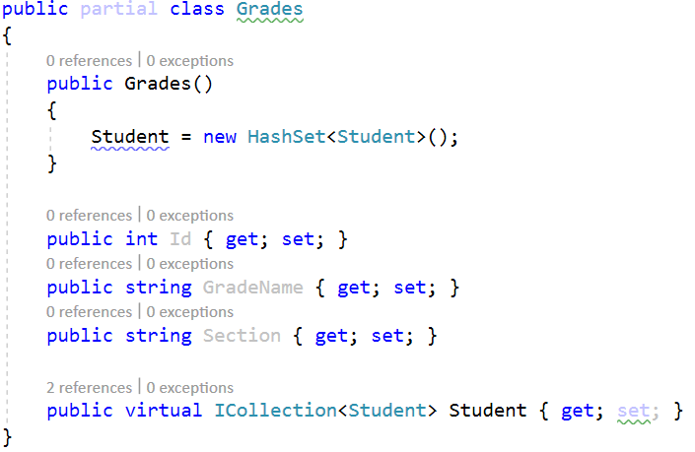
Relationship - Mapping object
1:N – Grades : Student

Slide 11
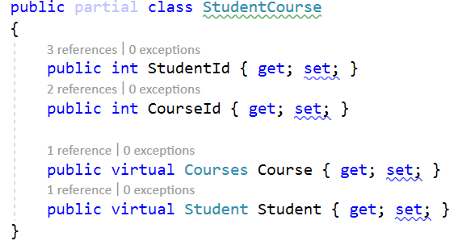
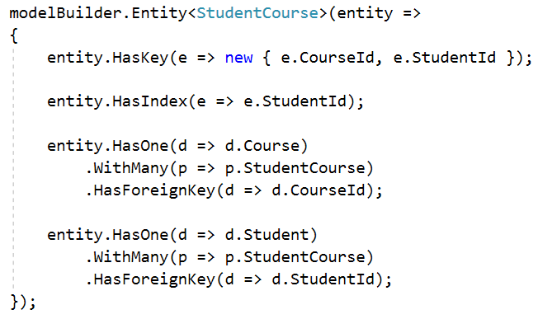
Relationship - Mapping object
N:N – Course : Student
1:N – StudentCourse : Course
1: N – StudentCourse : Student

Slide 12
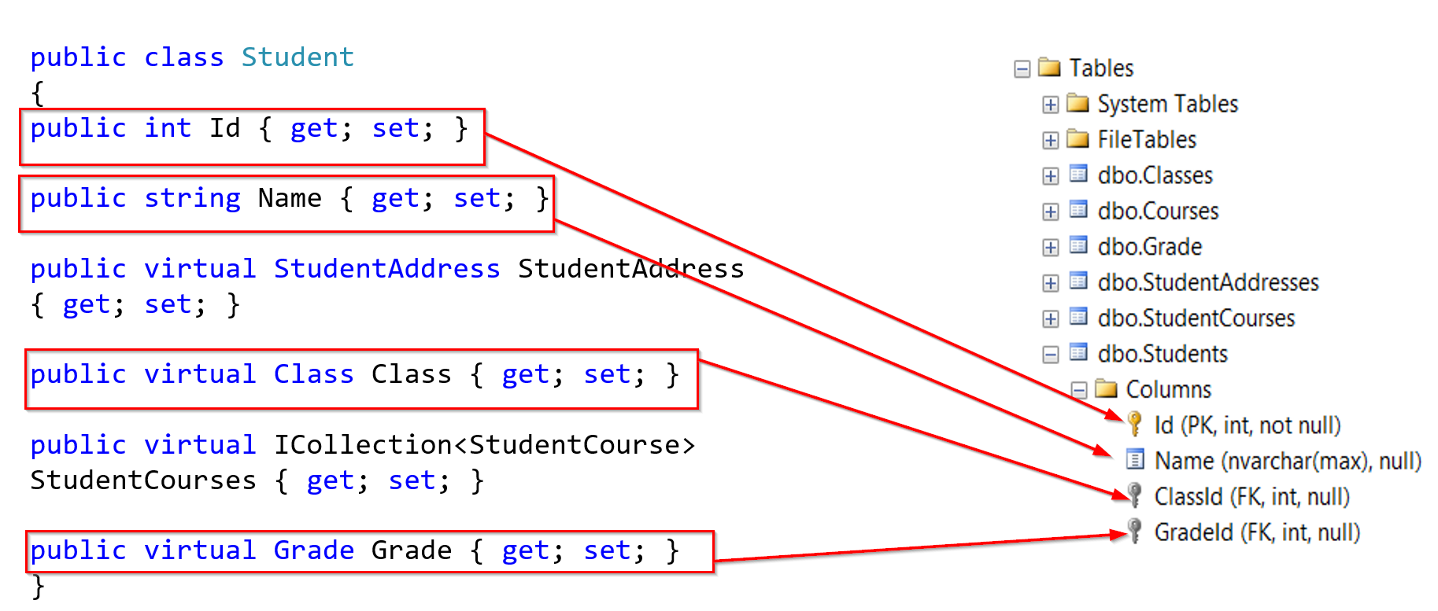
Code first

Slide 13
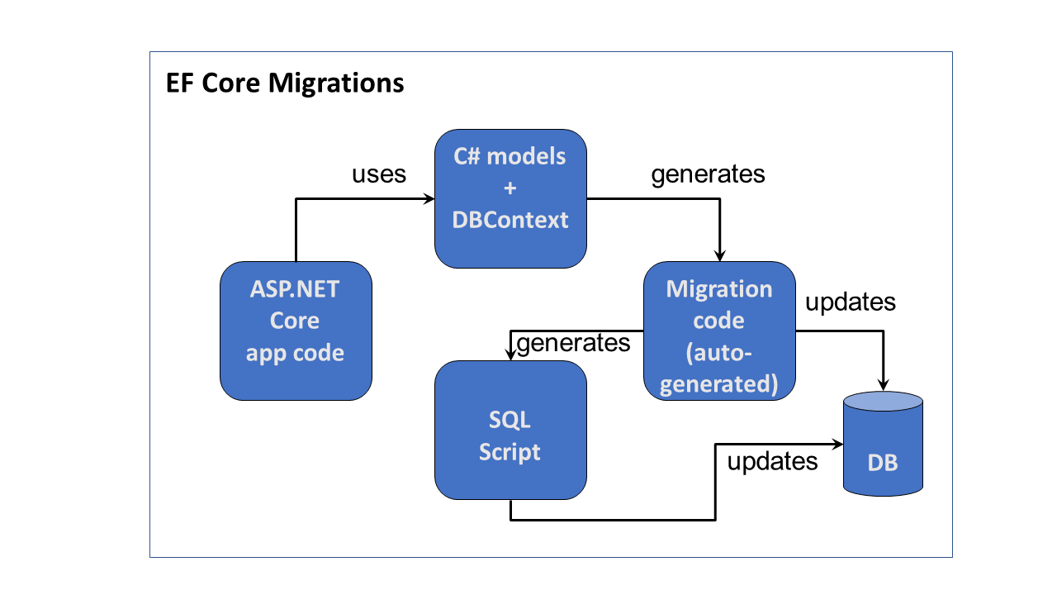
Migration
Command:
add-migration <migrationVersion>
update-database <migrationVersion>
Create/Update the database
Reverting a Migration
remove-migration
(Remove the last migration if it is not applied to the database)
1
2
2

Slide 14
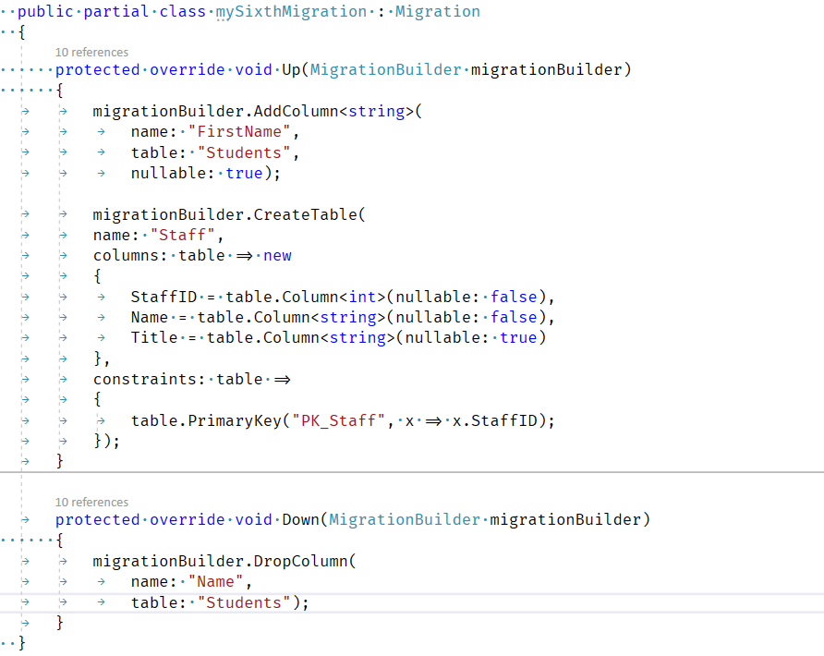
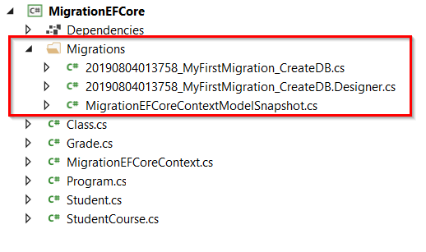
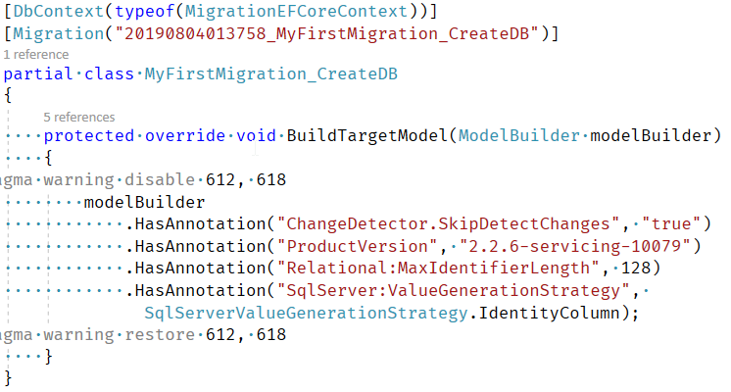
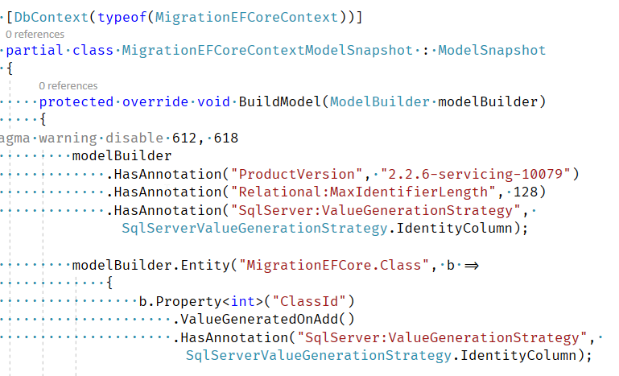
Migration
Adding a Migration
add-migration MyFirstMigration

Slide 15
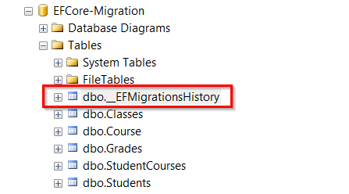
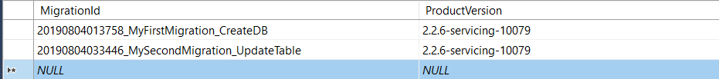
Migration
Create or Updating the Database
Update-database MyFirstMigration
The Update command will create the database based on the context and domain classes and the migration snapshot, which is created using the add-migration or add command.

Slide 16
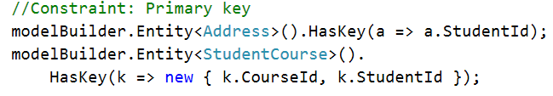
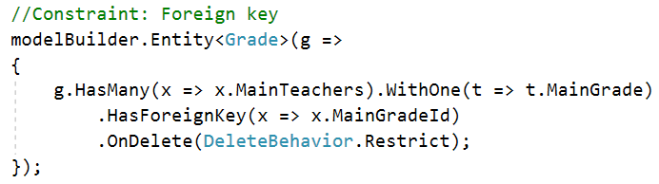
Constraints
PRIMARY KEY
FOREIGN KEY
UNIQUE
NOT NULL
DEFAULT
FOREIGN KEY
PRIMARY KEY
Reference:
https://www.learnentityframeworkcore.com/configuration/fluent-api

Slide 17
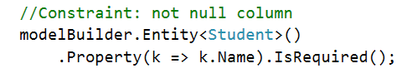
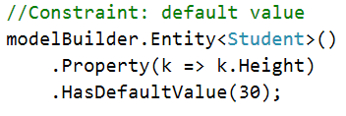
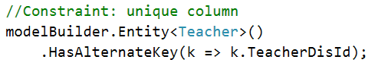
Constraints
NOT NULL
UNIQUE
DEFAULT

Slide 18
Validations
EF Core is not validation before save/update into Database
We need to write custom validation function
Run the custom function before call origin SaveChanges()
Reference: http://gigi.nullneuron.net/gigilabs/simple-validation-with-data-annotations/

Slide 19
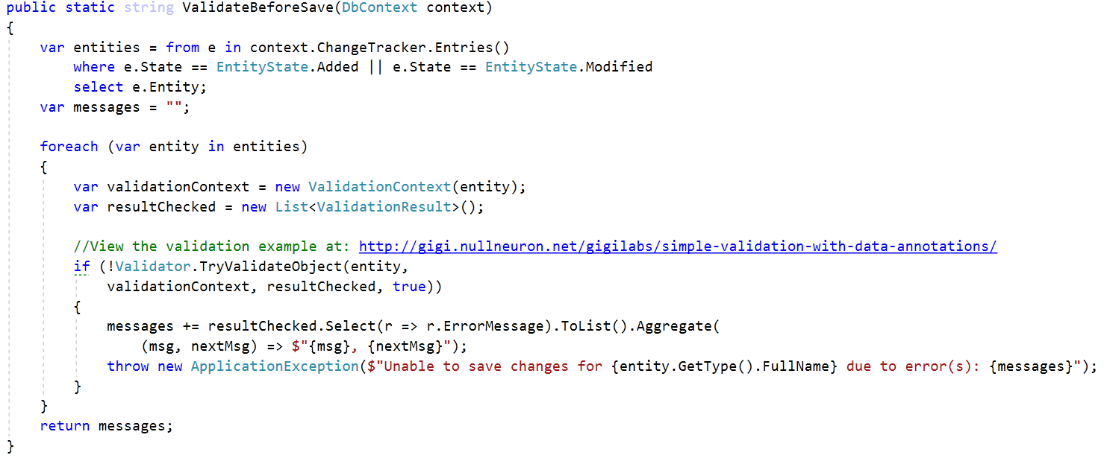
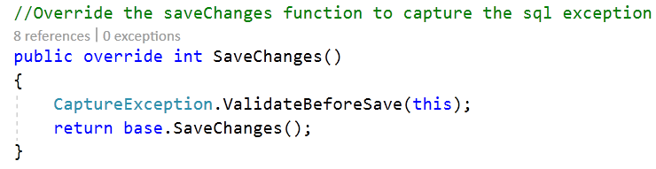
Validations

Slide 20
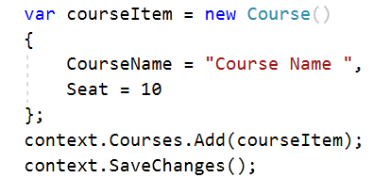
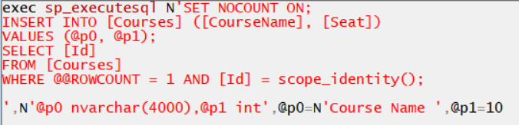
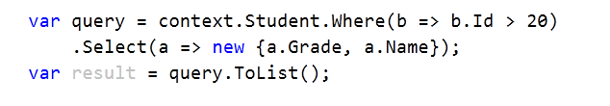
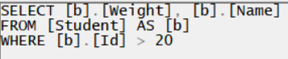
Excute query in Entity Framework
Insert, Update, Delete queries
Select query
The most common operations that result in the query being sent to the database are:
Iterating the results in a for loop
Using an operator such as ToList, ToArray, Single, Count
Databinding the results of a query to a UI

Slide 21
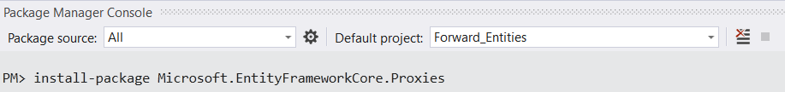
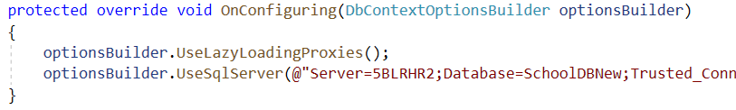
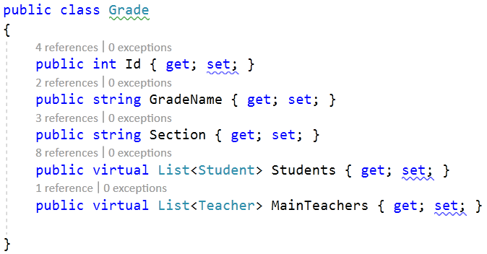
Loads strategies - Lazy Loading
Need add a package “Microsoft.EntityFrameworkCore.Proxies”
Enable it in config file in OnConfiguring
All navigate properties must be virtual – virtual proxy parttern

Slide 22
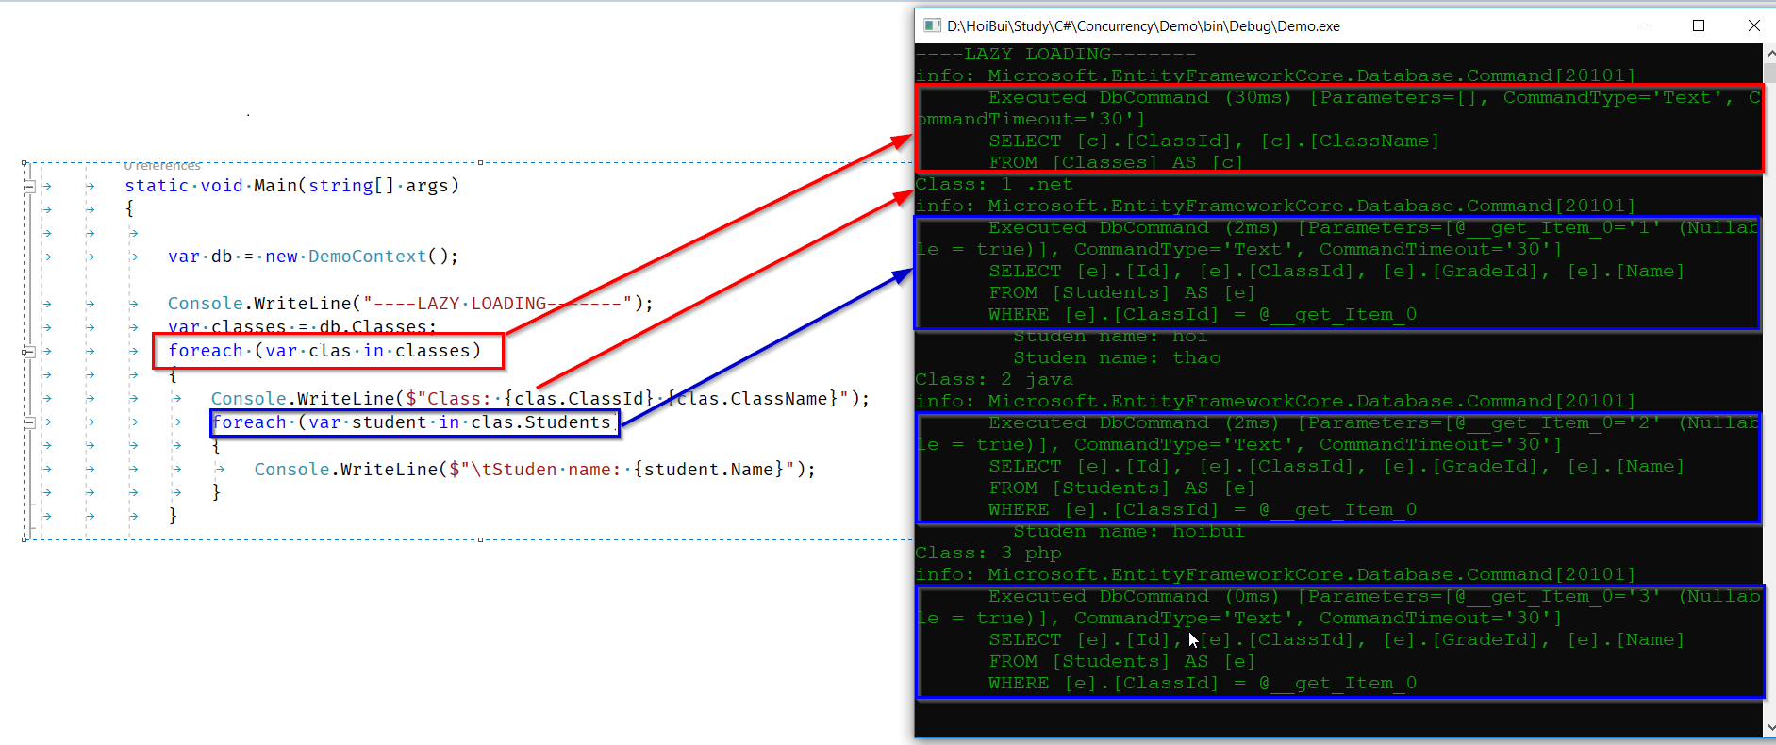

Slide 23
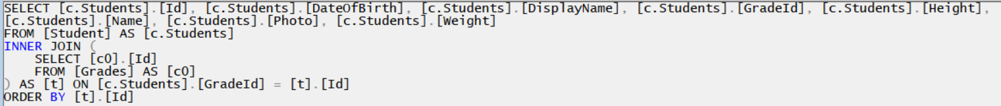
Loads strategies - Eager loading
Use Include/ThenInclude command
SQL Queries:

Slide 24
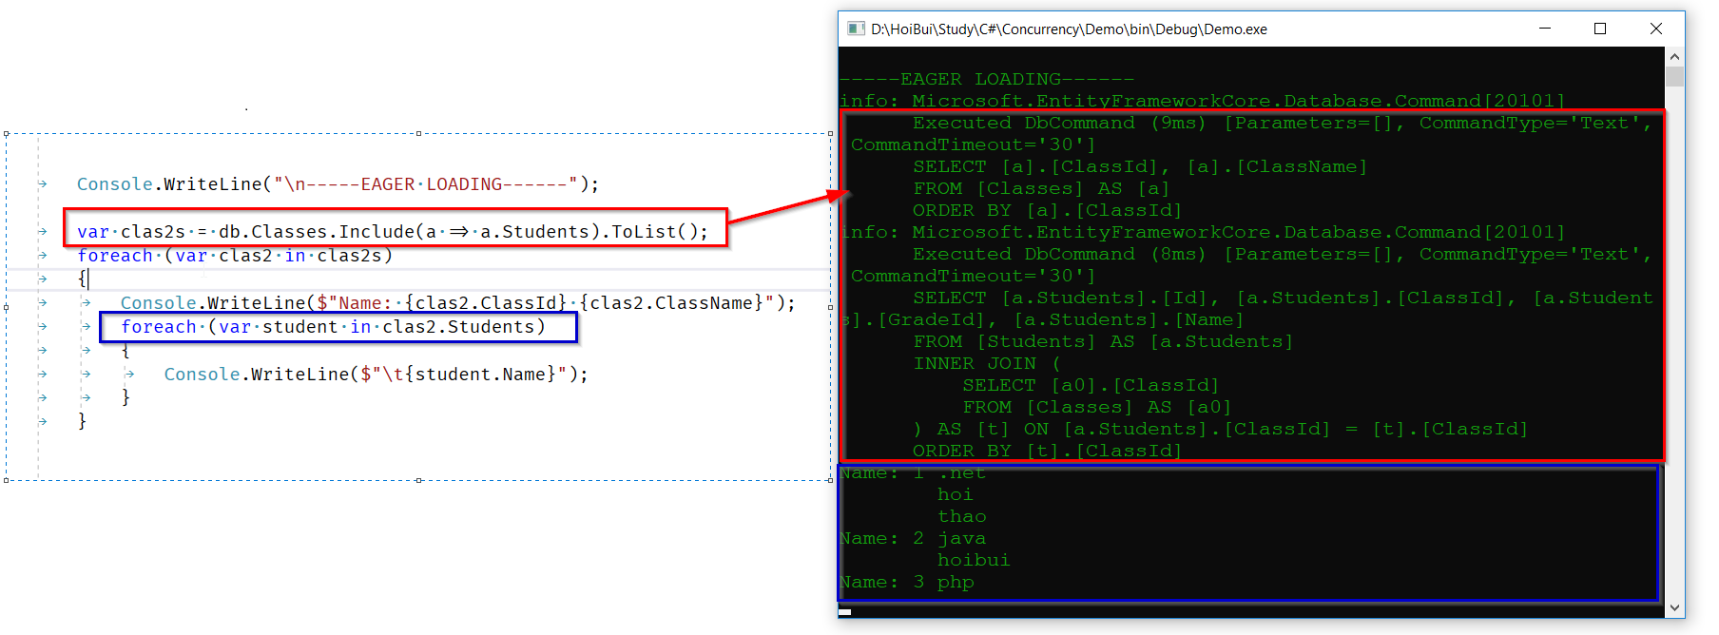

Slide 25
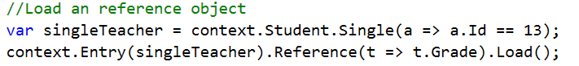
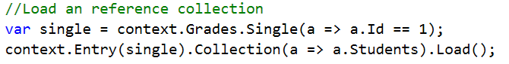
Loads strategies - Explicit loading
Load a reference object
SQL Queries:
Load a reference collection
SQL Queries:

Slide 26
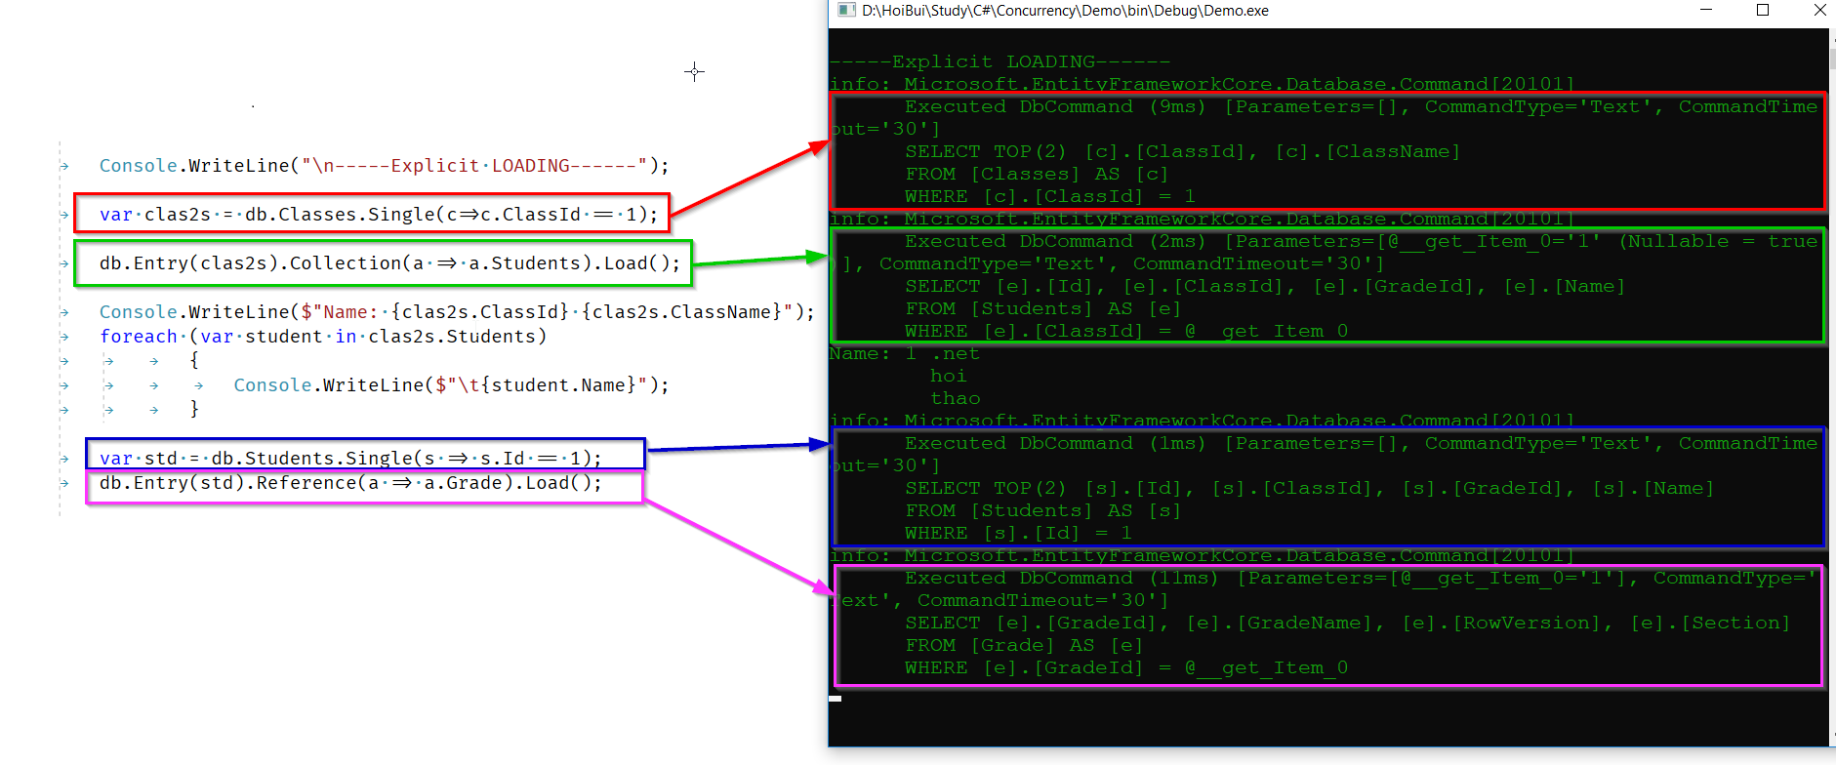

Slide 27
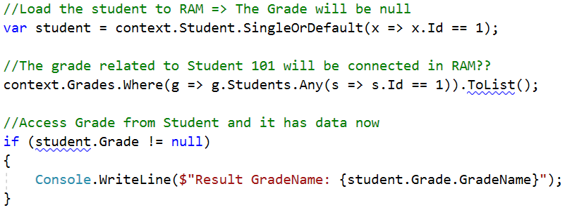
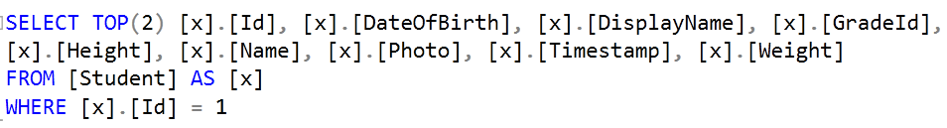
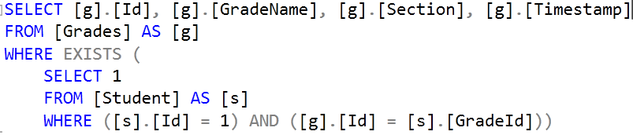
Loads strategies - PreLoading
1
2
2 queries are excuted separated but can access on RAM by reference realtionship
SQL Queries:
1
2

Slide 28
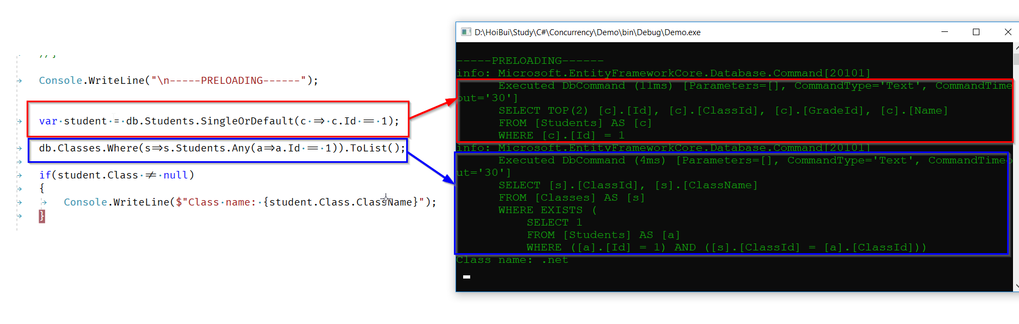

Slide 29
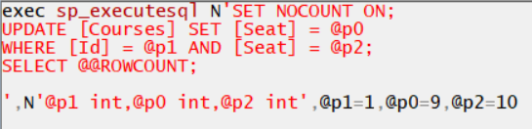
Concurrency
By default, it no lock at all. The last who writes wins
Need to config to detect the conflict if any.
Check the conflict individual
Check to detect for all properties
Check to detect by convention

Slide 30

Concurrency
Add Timestamp
Each table just has 1 timestamp column
If not, there is an error when run “update-database”
Type of the row: IsRowVersion()
The value of this column update whenever changes

Slide 31
Resolve conflict in concurrency
There are 3 options:
Reload the object: discard all changes in RAM
Call context.Entry(<Object>).Reload()
Override all changes: ignore changes of all other process
Loads the current state from the database
Set it to the original values of the object
After that, SaveChanges() with the override value
Re-calculate for both processes
Loads the current state from the database
Calculate the new value from Origin and current state
After that, SaveChanges() with the new value

Slide 32


Slide 33


Multi “and” condition in where clause
1
2
SQL Queries:
1
2
Notes:
http://www.albahari.com/nutshell/predicatebuilder.aspx
Move trc loading strategy

Slide 34


Multi “or” condition in where clause
Notes:
http://www.albahari.com/nutshell/predicatebuilder.aspx

Slide 35






Some functions
GroupBy – On RAM
SQL Queries:
Result:
GroupBy – On DB
SQL Queries:
Result:
Notes:
http://www.albahari.com/nutshell/predicatebuilder.aspx

Slide 36




Some functions
Inner join
Notes:
http://www.albahari.com/nutshell/predicatebuilder.aspx

Slide 37
Other functions
Count, Sum, Min, Max, Average
SubQuery
Left join
Cross join
…
Reference: https://docs.microsoft.com/en-us/dotnet/framework/data/adonet/ef/language-reference/method-based-query-syntax-examples-aggregate-operators
Notes:
http://www.albahari.com/nutshell/predicatebuilder.aspx

Slide 38

Transaction
Transactions allow several database operations to be processed in an atomic manner. If the transaction is committed, all of the operations are successfully applied to the database. If the transaction is rolled back, none of the operations are applied to the database.

Slide 39

Controlling transactions
Use the
DbContext.Database
API to work with transactions :
Begin
Commit
Rollback
The query can collect new student But only on this transaction

Slide 40


Cross-context transaction
(relational databases only)
We can also share a transaction across multiple context instances. This functionality is only available when using a relational database provider because it requires the use of DbTransaction and DbConnection, which are specific to relational databases.

Slide 41
Compare Entity Framework 6 (EF6) vs EF Core
OPTION | EF6 | EF Core
Introduction | As part of .NET Framework 3.5 SP1 and Visual Studio 2008 SP1 Runs on the .NET Framework 4.x, which means it runs only on Windows | Is a complete rewrite of EF6 Cross-platform product that can run on .NET Core or .NET Framework
Functions | Change tracking: Proxies Stored procedure mapping Lifecycle hooks (events, interception) Update model from database (Partial) … | Mapped types with no keys (query types) Property value conversions Field mapping Batching of statements …
Consider using | The app will run on Windows and the .NET Framework 4.0 or later EF6 supports all of the features that the app requires | The app needs the capabilities of .NET Core EF Core supports all of the features that the app requires
Notes:
https://docs.microsoft.com/en-us/ef/efcore-and-ef6/
Validation: https://fluentvalidation.net/start

Slide 42
Q & A

Slide 43
THANK
YOU!

